Slide 1
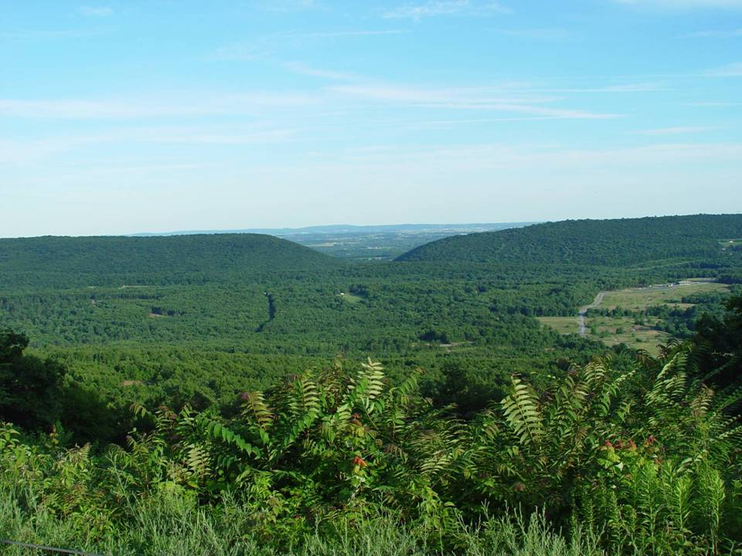
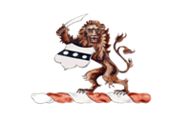
Saving the Regal Fritillary Butterfly
Joseph Hovis
PA Department of Military and Veterans Affairs
This Brief Is UNCLASSIFIED And FOUO
The Commonwealth of Pennsylvania
Department of Military and Veterans Affairs
Notes:
Material provided by Joseph Hovis and modified by Laurie Schoonhoven, Pennsylvania State University

Slide 2
Diversity at Ft. Indiantown Gap
39 Species Of Mammals and 118 Birds
38 Species Of Reptiles And Amphibians
27 Species Of Fish (including wild trout)
792 Species Of Plants
13 Forest Communities
Expansive Grassland, Savanna, Barrens, and Old-growth Forest Areas
5 Wetland Communities
Notes:
Regal fritillary butterfly can be found in Fort Indiantown Gap military proving grounds and Virginia as well as the Midwestern great plans.
Fort Indiantown has diverse plant and animal life including…

Slide 3
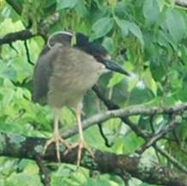
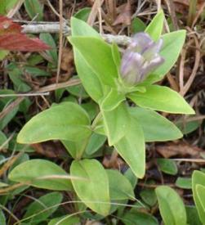
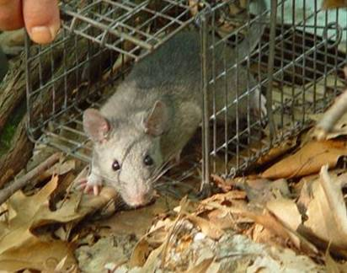
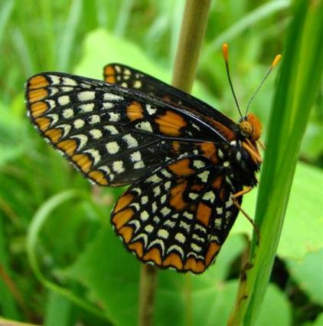
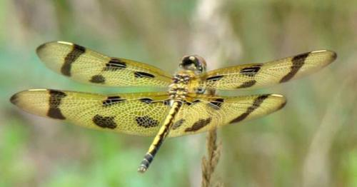
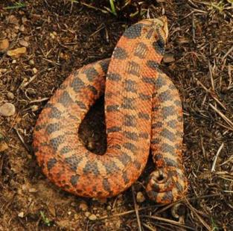
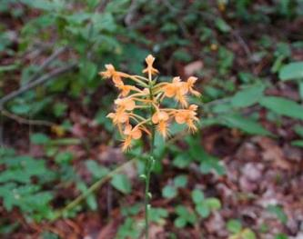
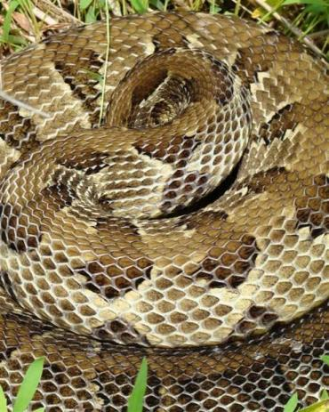
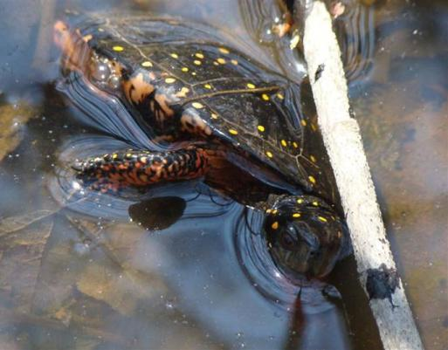
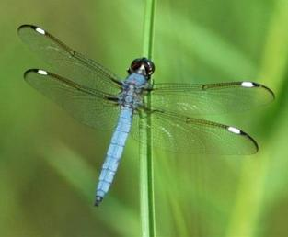
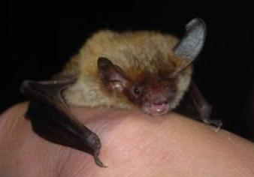
Cast of Rare Critters
Notes:
Fort Indiantown Gap biologists manage for rare species including (clockwise from top left): black-crowned night heron, Allegheny wood rat, hog nose snake (orange snake), brown bat, timber rattle snake, and spotted turtle. Military training can have an impact on rare species and vice versa.

Slide 4
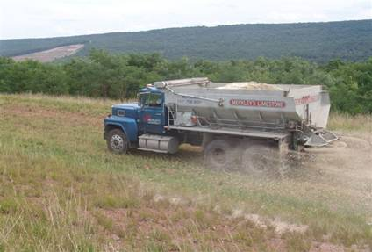
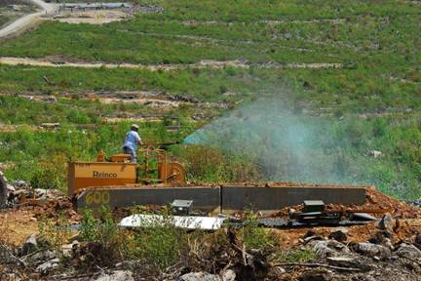
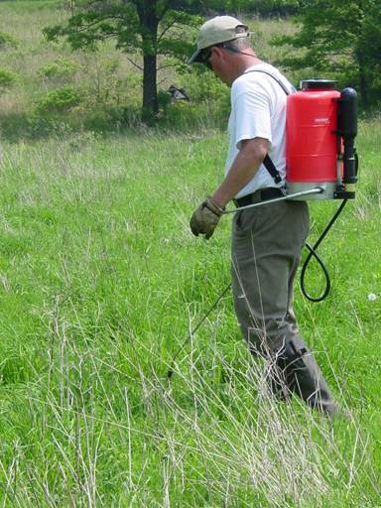
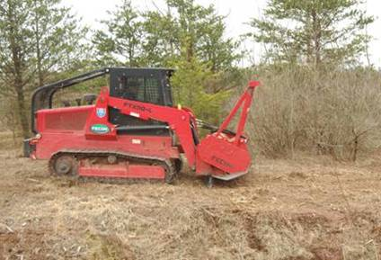
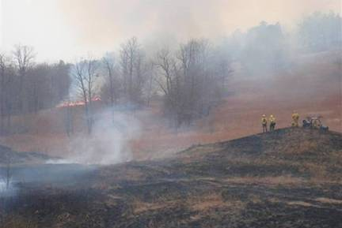
Methods used to manage landscape
Seeding
Lime Supplement
Herbicide
Prescribed Fire
Reclamation
Notes:
A variety of techniques are used to maintain diverse landscapes for military training and preserving habitat for rare species.
Lime fertilizes the soil.
Seeding disperses desirable grass and plant seeds.
Prescribed fire or controlled burns create bare soil conditions.
Reclamation uses mechanized tree harvesters to remove trees.
Herbicides kill unwanted native and exotic invasive plants. Exotic invasives are plants from other places (US or other countries) introduced by humans.

Slide 5
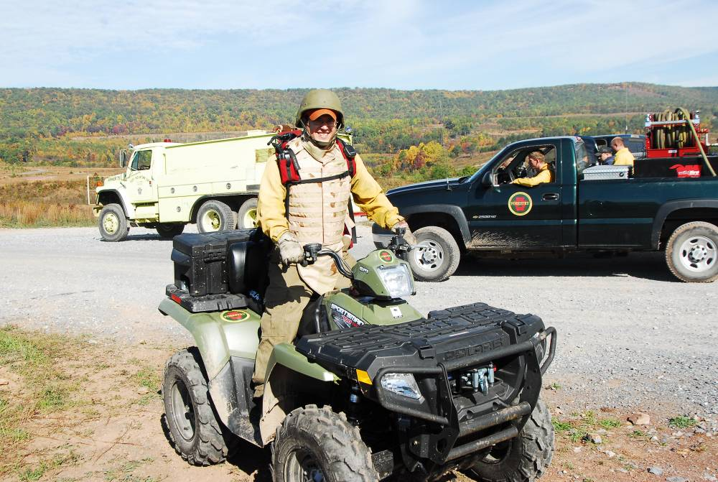
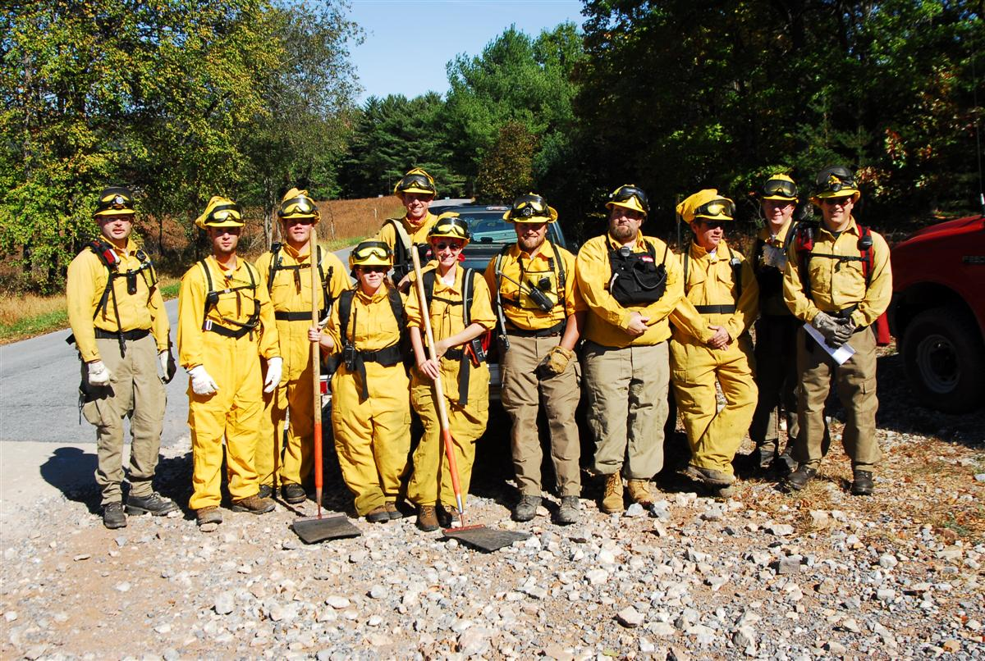
Fire History
Agricultural fires (Pre-1930)
Unplanned military fires & “controlled burning” (1933-2001)
Planned controlled burns & unplanned military fires(~2001-present)
Notes:
Fort Indiantown Gap and Pennsylvania has a history of “controlled burns.” Native Americans burned to clear land for agriculture, improving hunting as burned-over sites provide plant re-growth for wildlife. Early settlers followed Native American practices and cleared land for farming by cutting and burning trees and shrubs.
Controlled burns are planned by trained professionals. Note: bottom left photo includes water truck (back right) to extinguish flames. All controlled burn personnel wear protective clothing. This includes Nomex (yellow fireproof) pants and shirts, goggles, helmets, boots, and gloves. They are trained in fire management including building fire breaks and extinguishing fires.

Slide 6
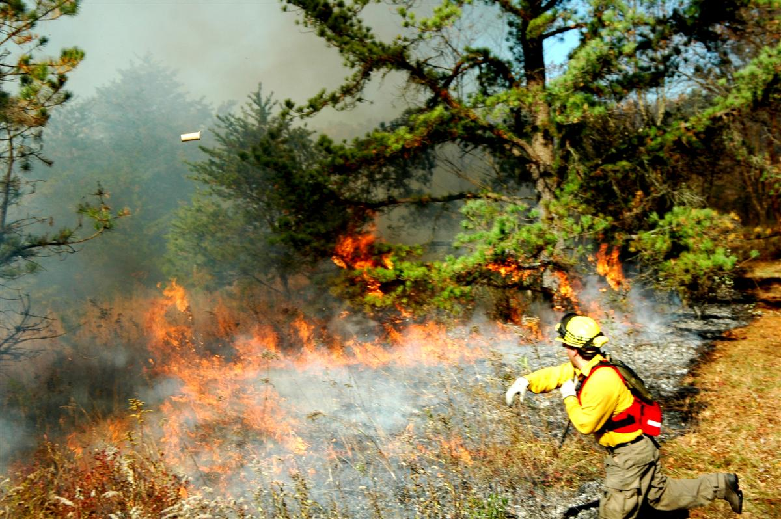
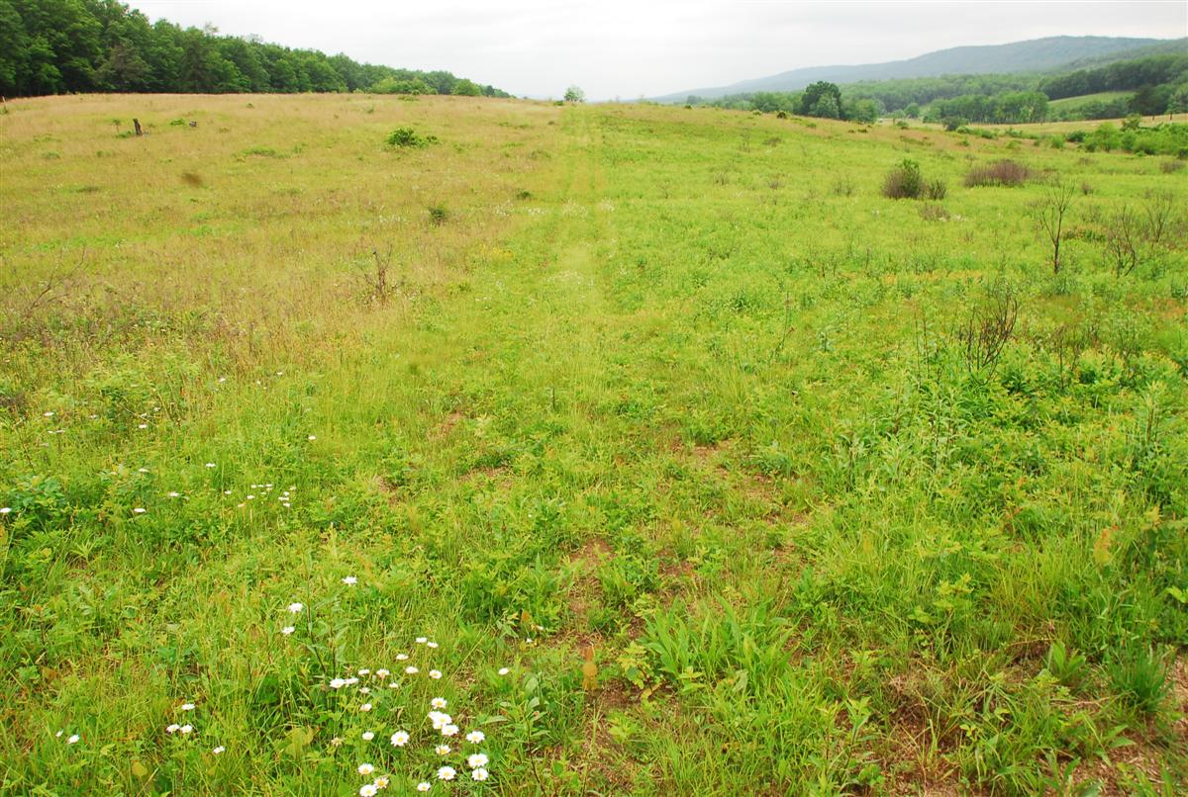
Fire Effects On Habitat
Decreases
# of trees & shrubs per acre
Leaf/grass, twigs and branches
Notes:
Controlled burns can have both positive and negative impacts on the landscape. Biologists and natural resource managers use fire to create desired outcomes such as killing undesirable trees and shrubs. It also burns dead leaves, grass, and twigs. Negative impacts include damaging or killing desirable plants and trees as well as seed sources. Control burn managers try to minimize negative impacts. Ultimately, repeated controlled burns create open fields.
Note: the person in the lower left image is throwing a fire starter. It is a fire management technique.

Slide 7
Fire Effects On Habitat
Increases
# of standing dead trees in landscape
% of Oak In Forest
Diverse forests and landscapes
Soil pH (in the short-term)
Available Nutrients (from burnt plants/branches)
Soil Temperature
Sunlight & Bare Soil For Seed Germination
Notes:
Controlled burns also have positive effects. Standing dead trees provide habitat for insect as well as homes for woodpeckers and other animals. Increased oak trees lead to more acorns. Wildlife such as deer, turkeys, and squirrels eat acorns. Fires are used to create patches of forests and meadows. This diverse landscape provides habitat for a wide variety of plants and animals.
In addition, fire ashes provide important nutrients to the soil and create bare soil. Some plants (violets for regal fritillary) need bare soil, increased sunlight, and warm soil temperatures to germinate/grow.

Slide 8
Notes:
There are several phases for a controlled burn: (note: Image appear as you advance the presentation. Pictures are sequenced top left/right and bottom left/right.)
1. First, biologists and natural resource managers inventory (identify and count) plant and tree species in the area selected to burn. They measure the slope of the land (fire moves faster on steeper slopes). They also look at the weather including expected precipitation (rain), wind direction and speed, and relative humidity. The information is used to develop a burn plan. The burn is only done when it is safe and the fire can be controlled. (Press enter or forward arrow for second image.)
2. Trained professionals start, manage, and extinguish the controlled burn. They wear protective clothing and have water and equipment ready to extinguish the fire. The fire in the slide is low intensity with short flames. Burn done in April 2005. (Press enter or forward arrow for third image.)
3. The landscape after the burn. Remember the burnt grass and plants provide nutrients to the soil. (Press enter or forward arrow for fourth image.)
4. The warm, bare soil is filled with nutrients new plants need to grow. Here is the same field two months after the controlled burn. Look at the abundant green grass. The same field in June 2005.

Slide 9
Notes:
Regal fritillary habitat. Left side of road was burnt two years ago and right side was burned the previous year. The fire ultimately provides the regal fritillary and native plants.

Slide 10
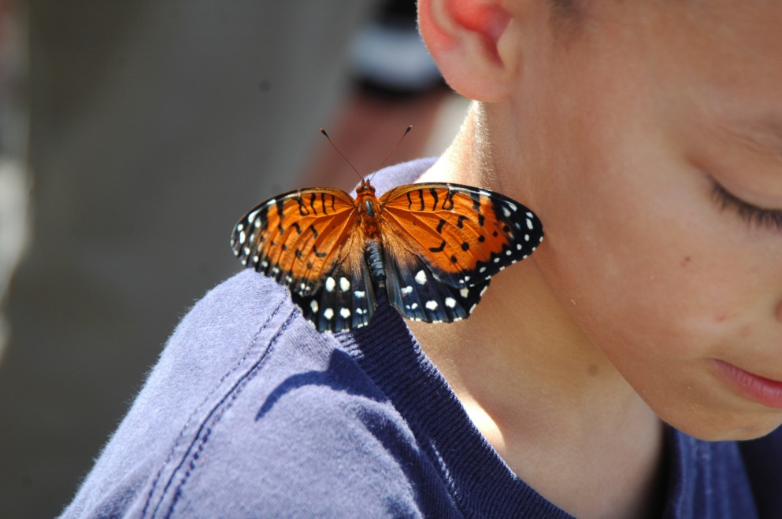
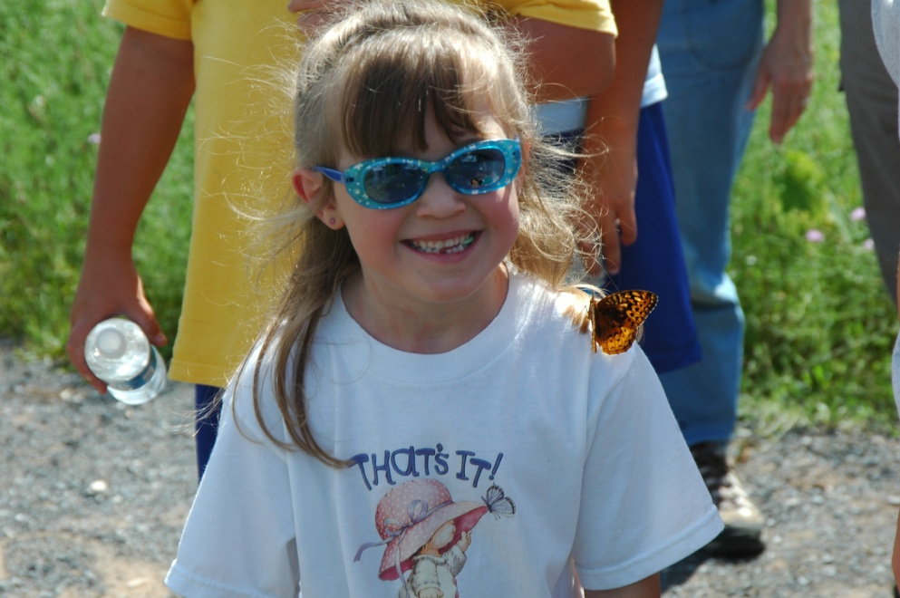
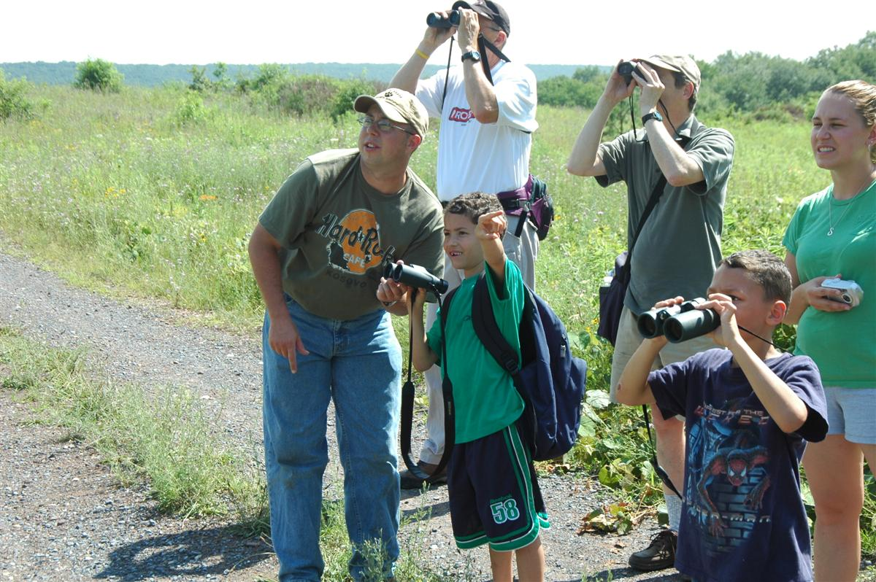
Notes:
Ultimately, families enjoy observing the butterfly in its natural/native habitat.

